Slide 1



ETF SARAJEVO · NUMERICAL OPTIMIZATION
Robot Trajectory Optimization
Teaching a robot to steer itself along a path — safely, using math instead of guesswork.
What it does
How it decides
Why it matters
Works out the exact steering angle and speed a robot needs, instant by instant, so it follows a path without ever crashing.
Solves a small math problem at every step instead of searching a map like a maze-solver
Same idea (Model Predictive Control) used in real self-driving cars and robots, built here from scratch for a university course.
Emin Hadžiabdić · Numerical Optimization · Prof. Dr. Izudin Džafić · 2025 / 26
github.com/ehadziabdic/RobotTrajectoryOpt
01

Slide 2

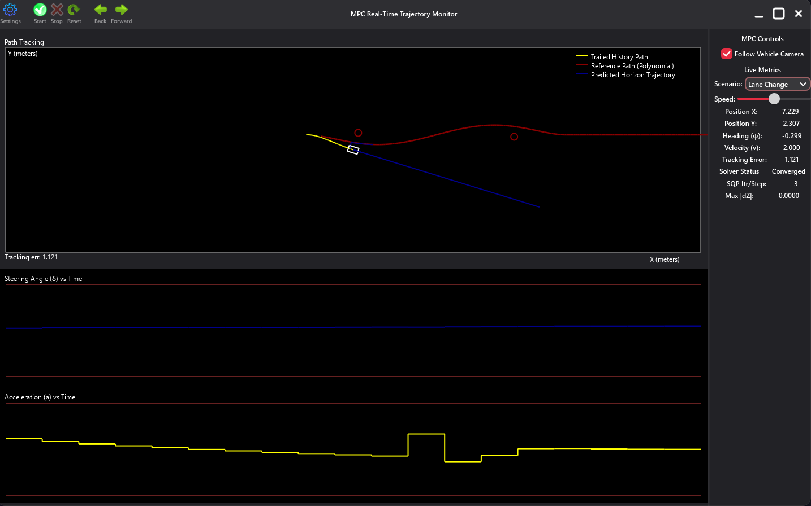



HOW IT WORKS
Sense, Plan, Solve, Act — Ten Times a Second
Sense
Where is the robot right now - position, heading, speed.
Plan
Redraw a smooth target path starting from here.
Solve
An Active-Set QP solver, wrapped in an SQP loop, finds the best steering + acceleration for the next 2 seconds - never breaking the robot's limits.
Act
Send just that first move to the real robot.
Repeat
Do it all again, about 10 times a second.
Live run — yellow: driven path · red: target path · blue: direction / calculation offset
C++17
natID framework
Sparse LDLᵀ solver
Active-Set QP + SQP
BUILT WITH
02

Slide 3
FEATURES & DOWNLOADS
Try It Yourself
Real-time GUI
3 built-in scenarios
Live path, predicted horizon & obstacles, redrawn every step.
Straight Line, Lane Change, S-Curve.
DOWNLOAD
Windows ↓
Tunable solver settings
6 UI languages
Linux ↓
Iterations, tolerance and step size, adjustable live.
English, Bosnian, German, Spanish, French, Japanese.
macOS — Apple Silicon ↓
Cross-platform
Open source
macOS — Intel ↓
Windows, Linux, macOS (Intel & Apple Silicon).
MIT license, C++17, no outside libraries.
github.com/ehadziabdic/RobotTrajectoryOpt
MIT License
03

